Slide 1
RosettaLigand Docking Tutorial
Rosetta Workshop – December 14th, 2017
Shannon Smith
shannon.t.smith.1@vanderbilt.edu
Graduate Student, Meiler Lab
Vanderbilt University

Slide 2
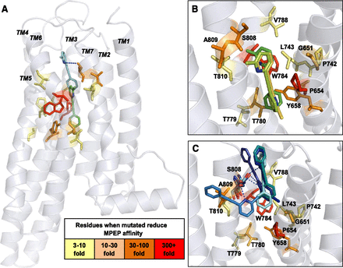
Ligand Docking and Rosetta
K. J. Gregory et al., Probing the metabotropic glutamate receptor 5 (mGlu5) positive allosteric modulator (PAM) binding pocket: discovery of point mutations that engender a “molecular switch” in PAM pharmacology., Molecular pharmacology 83, 991–1006 (2013).
Notes:
The NAM MPEP docked into the mGlu₅ comparative model. MPEP was docked into the mGlu₅ comparative model in two separate experiments, centered at P654 and S808. (A) The lowest-energy conformation for MPEP from the largest cluster docked at P654 is shown in green and at S808 is shown in cyan. Highlighted are the residues that caused decreases in MPEP affinity when mutated, colored by graded effect compared with wild type. (B) The lowest-energy models from the largest three clusters for MPEP docked at P654. (C) The lowest-energy models from the largest five clusters for MPEP docked at S808. Predicted hydrogen bonds between the nitrogen on the pyridine ring and S808 are depicted by dotted blue lines.

Slide 3
Some Quick and Dirty Terminology
Ligand: small molecule binder (“drug-like”)
Chain: identifier for protein/ligand molecule
Low-resolution/Coarse-grained: fast centroid or grid based sampling steps
High-resolution/Atomistic: full-atom steps with complete Rosetta energy function
Integer: 0,1,2,3,4…etc.
Float: 1.2, 2.3, 0.78…etc.
Boolean: True/False
String: alpha/numeric/symbol combination

Slide 4
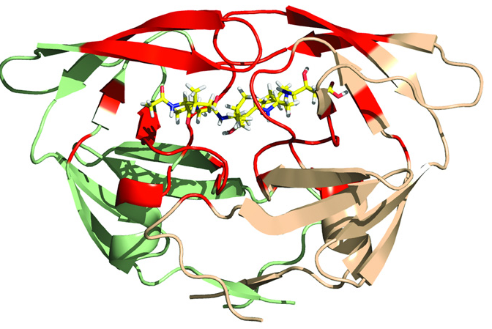
RosettaLigand History
Meiler and Baker 2006
Protein and ligand ensembles
Side chain flexibility
Davis and Baker 2009
Backbone flexibility near binding site
Lemmon and Meiler 2012
XML Scripts
Deluca and Meiler 2015
High throughput screening and improved low resolution sampling
HIV-1 PR homodimer (green/wheat) with acetylpepstatin (yellow) in binding site (red)
G. Lemmon et. al. Chemical biology & drug design (2012).
Notes:
Meiler – initial RosettaLigand paper, algorithm looks at ensemble of protein / ligands, picks, orients ligand, repacks sidechains
Davis – backbone flexibility, previously the backbone was left rigid
Lemmon – introduction of XML scripting, something that you will be using today, making designing your own protocols easier
Deluca – reduction in time by improving algorithms, both more efficient (less models), and faster, better for virtual HTS

Slide 5
When is RosettaLigand likely to work?
Crystal structures (ideally in complex with ligand of similar chemotypes)
Rigid, well-defined binding pocket
Drug-like small molecules capable of making hydrophilic/H-bond interactions
Experimental restraints
Docking (finding binding mode) is much easier than ranking or predicting activity!
Davis, I. W., Raha, K., Head, M. S. & Baker, D. Blind docking of pharmaceutically relevant compounds using RosettaLigand. Protein Sci. 18, 1998–2002 (2009).
Notes:
Davis 2009, Kauffmann docking into comparative models 1. Davis, I. W., Raha, K., Head, M. S. & Baker, D. Blind docking of pharmaceutically relevant compounds using RosettaLigand. Protein Sci. 18, 1998–2002 (2009).

Slide 6
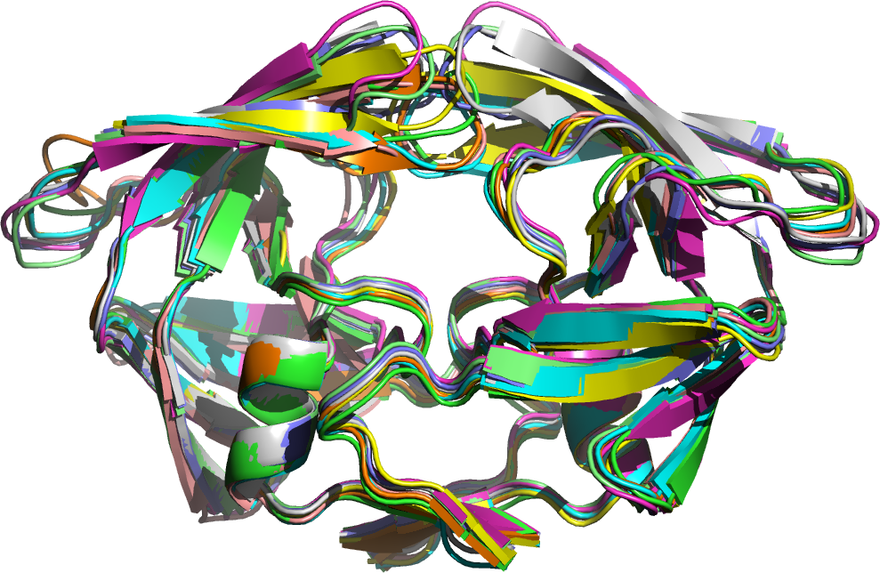
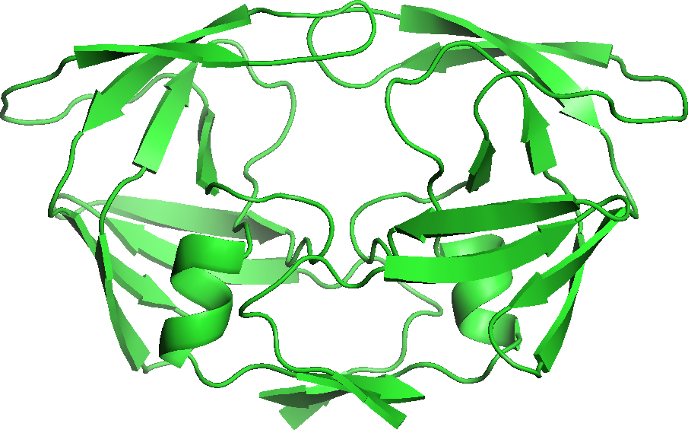
Protein Model Selection
Protein conformation sources:
Crystal structures/NMR
Comparative modeling
Better to run dock into multiple models
Notes:
Dock into multiple structures to better sample conformational space.

Slide 7
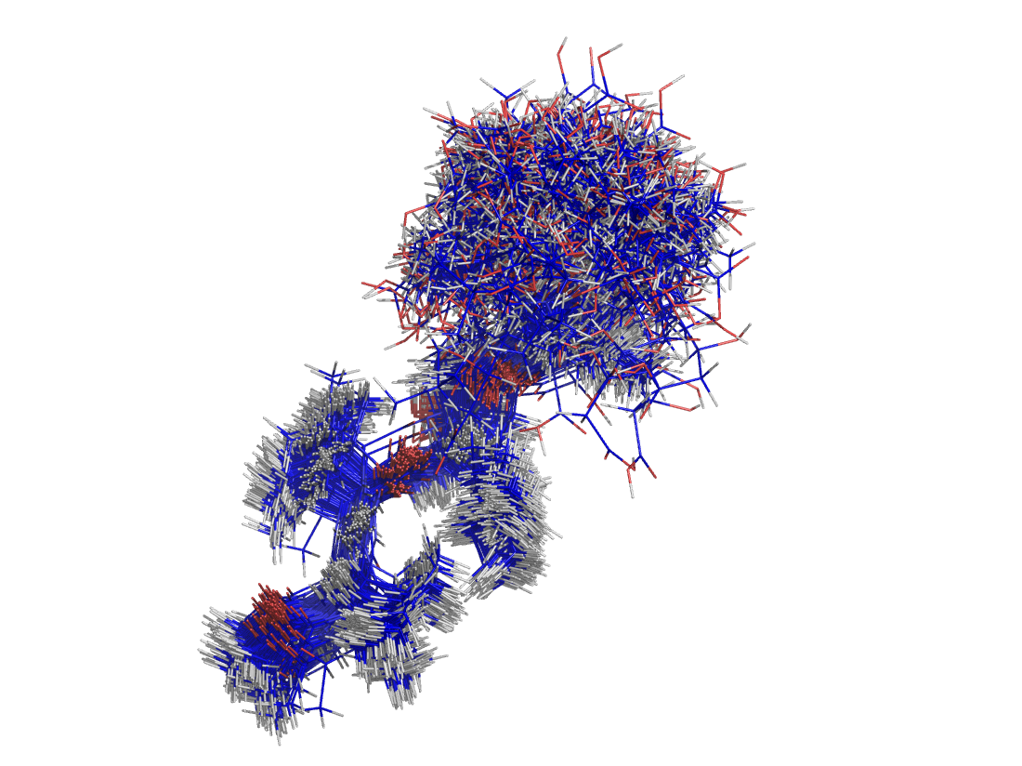
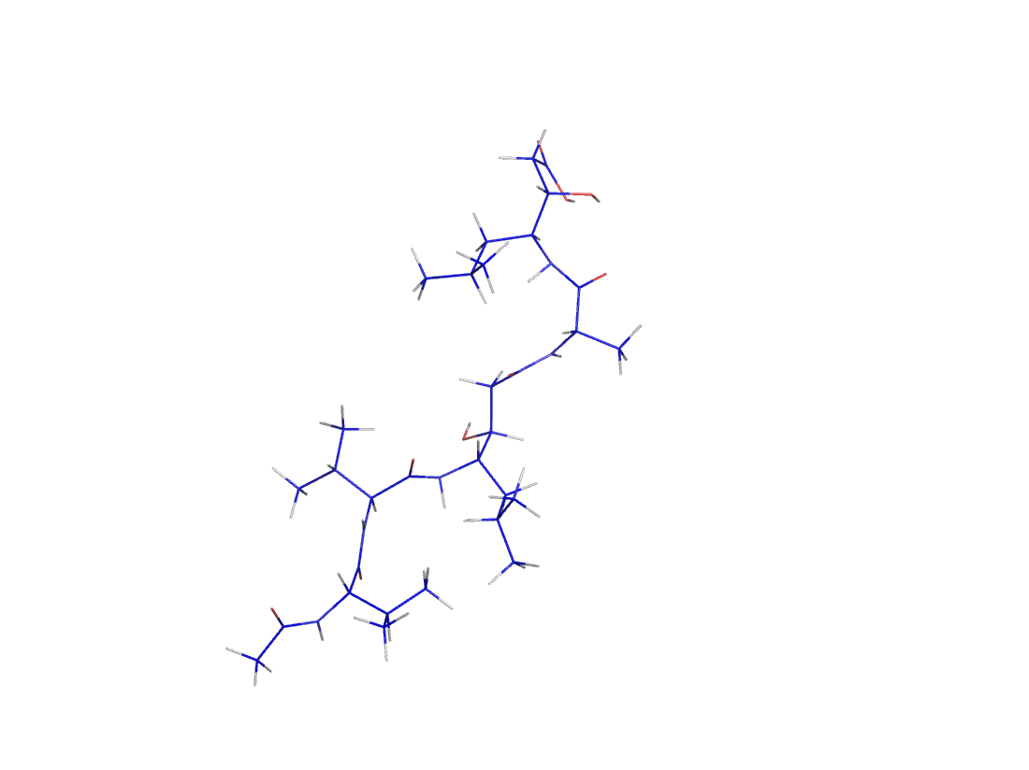
Ligand Conformer Generation
Ligand conformation sources:
BioChemicalLibrary (BCL) http://www.meilerlab.org/servers/bcl-academic-license
Commercial software: MOE/OpenEye
FROG2 Server http://bioserv.rpbs.univ-paris-diderot.fr/services/Frog2/

Slide 8
The Ligand Params File
Residue Parameter Files define:
Residue name and type
Atom names, types, and charges
Bonds, chi angles, and rotamers
Internal coordinates
Additional properties
Points to conformer file
Rosetta Database has existing parameter files for amino acids, but we need to generate custom ones for ligands
Script to generate params file:
/$ROSETTA/main/source/scripts/python/public/molfile_to_params.py
Notes:
3 pieces of info that Rosetta/computer NEEDS to have to put a ligand together.
Atoms
How are they bonded to each other?
Position in space (angles, rotamers, etc.
Rosetta Database also has params files for other commons ligands (nucleic acids, non-canonical AAs, carbs, etc.)

Slide 9
RosettaLigand Algorithm Overview
Low Resolution
Coarse Grained
High Resolution
Atomistic
Initial Placement
Small ligand moves
Interface side-chain moves
Monte Carlo
accept/reject
Gradient based minimization
Transform
Final minimization

Slide 10
Overview of XML Script
SCOREFXNS
Soft-rep
Hard-rep
SCORINGGRIDS
LIGAND_AREAS
INTERFACE_BUILDERS
Side-chain and backbone
MOVEMAP_BUILDERS
Docking and Minimization
MOVERS
StartFrom
Transform
HighResDocker
FinalMinimizer
InterfaceScoreCalculator
Low Resolution Steps High Resolution Steps Evaluation Steps

Slide 11
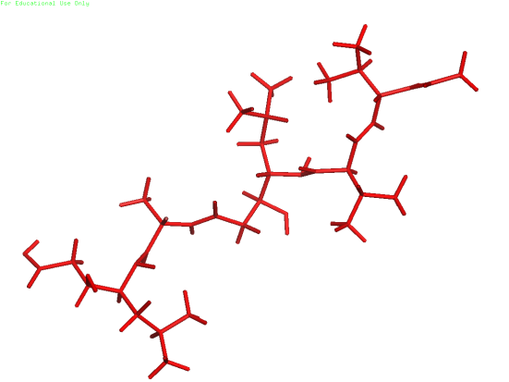
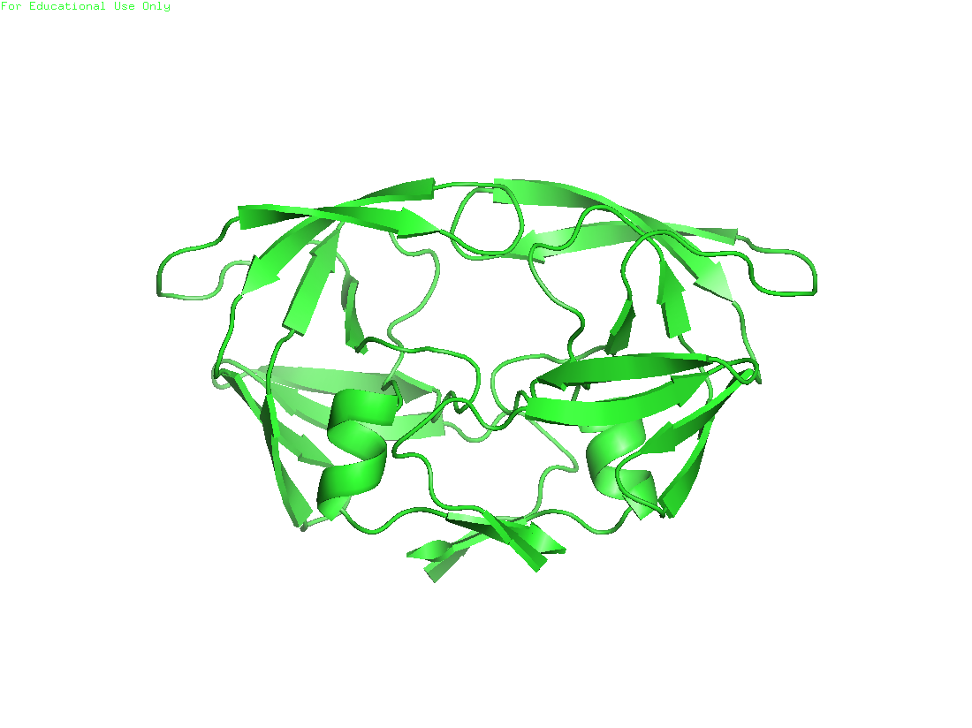
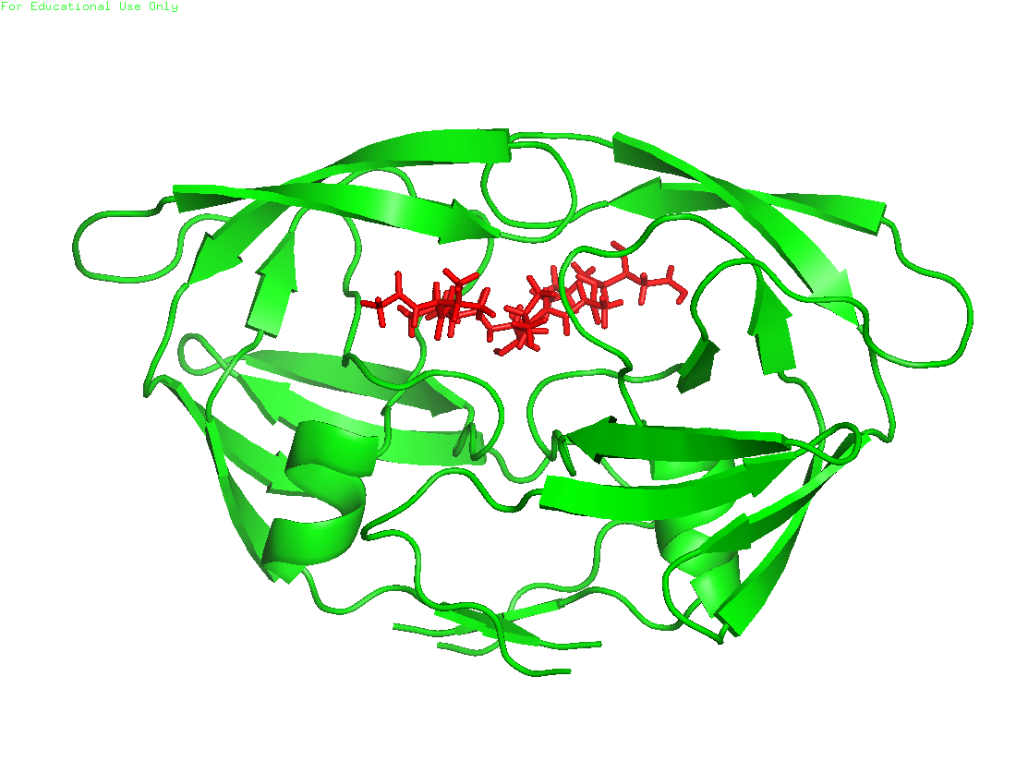
RosettaLigand Algorithm
Initial placement
Transform
Docking Cycles
High res refinement
Notes:
Optionally move ligand to user specified centroid

Slide 12
StartFrom
Can also manually move ligand to the starting position
<StartFrom name=(string) chain=(string)/>
<Coordinates x=(float) y=(float) z=(float)/>
</StartFrom>
Places the centroid of the ligand into the starting spot
Optional. Provide a list of possible XYZ starting coordinates. One of these will be chosen at random for initial ligand placement.
Notes:
Helpful when doing benchmarking as you can specify these coordinates to start from

Slide 13
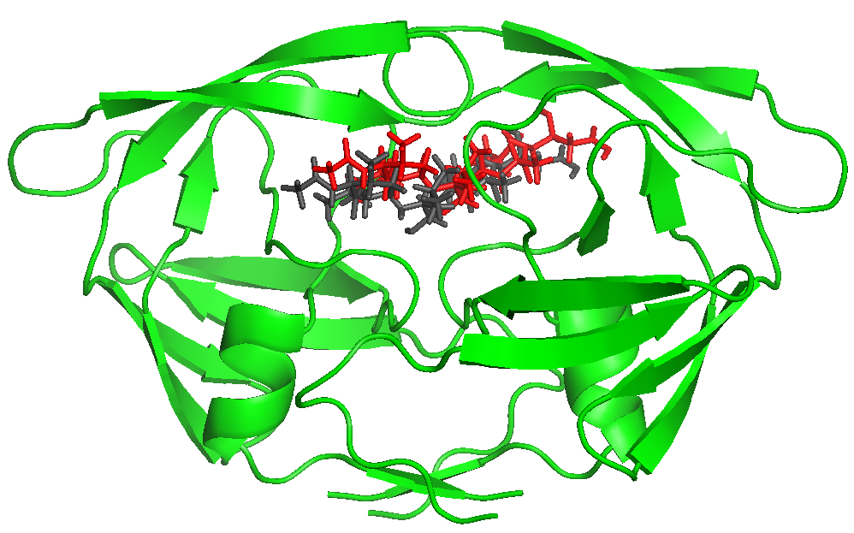
RosettaLigand Algorithm
Initial placement
Grid based Monte-Carlo Translation, Rotation, and Conformation Sampling
Transform
Docking Cycles
High res refinement
Notes:
Perform an initial random translation (50 chances to find an empty spot).

Slide 14
Transform Algorithm
Start
Random Conformer Change
Random Translation + Rotation
Flip a Coin
Did the Score in the Grid Improve?
Yes, Keep Move
No, Monte Carlo
Notes:
--
Iterate through cycles of small random moves, minimizing and repacking, accepting the current structure with a Boltzmann criterion.

Slide 15
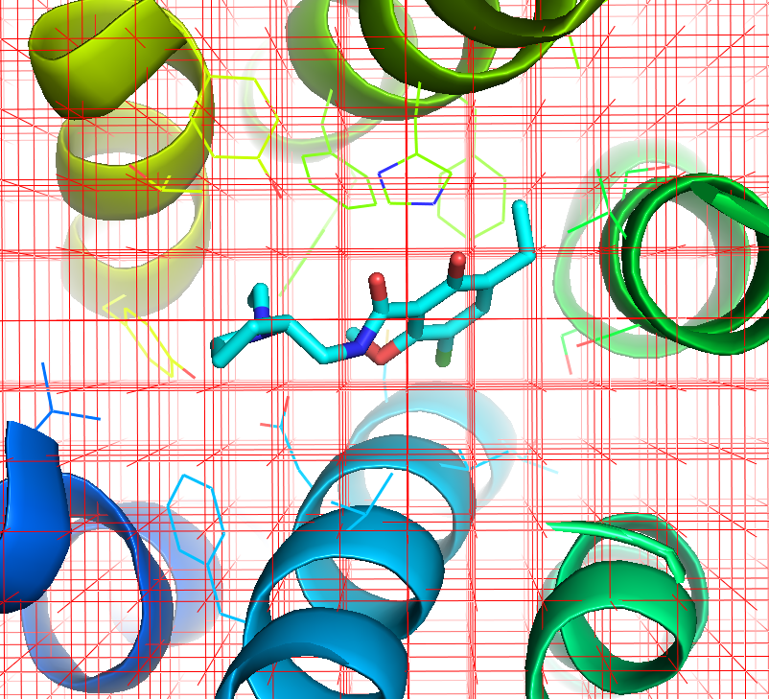
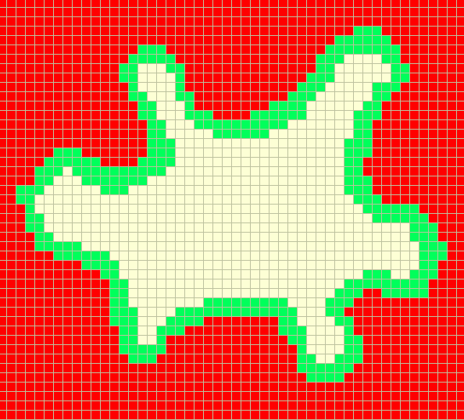
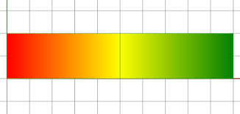
Setting Up The Grid for Transform Step
Repulsive Attractive
+1 0 -1
Where the ligand can move/transform
Calculates score at each point in grid
Determines where the ligand can move
This only based on sterics
Notes:
Why both box and grid? -- maybe historical artifact left over from when memory was more limited?

Slide 16
Grid Manager
<SCORINGGRIDS ligand_chain=(string) width=(float)>
<classic grid_type=“ClassicGrid”weight=(float)/>
<Another Grid>
</SCORINGGRIDS>
Sets up scoring the grid(s) around the ligand
Ligand_chain: Identifies the ligand to build around (Typically X)
Width: Grid width to keep all atoms in
GridType: Type of grid to use, classic grid is shape complementarity
Weight: Scoring weight to use if we have multiple grids

Slide 17
Transform Step
Center: Initial center of ligand that acts as center of grids
Box size: The center of ligand cannot move outside this box
Grid Width: No ligand atoms are allowed outside this box
Translation: Random 3D translation between 0 and move distance (Gaussian distribution)
Rotation: Random 3D rotation between 0 and angle
(Gaussian distribution)
zz

Slide 18
Transform
<Transform name=(string) chain=(string) box_size=(float) move_distance=(float) angle=(float) cycles=(int) repeats=(int) temperature=(float)/>
Monte Carlo transformation of ligand in grid
- Chain: Ligand chain to move
- Box_size: Distance from starting position to restrain ligand center
- Move_distance: Max translational distance of a single move
- Angle: Max angular rotation of a single move
- Cycles: Number of Monte Carlo steps to perform
- Repeats: Number of times to perform cycles from starting position
(EX: 3 repeats of 500 cycles means 1500 total steps)
- Temperature: Factor that controls determining how often an unfavorable move is accepted by Monte Carlo

Slide 19
RosettaLigand Algorithm
Initial placement
Move Ligand
Transform
Rotamer Trials
Full Repack
Docking Cycles
Gradient-based Minimization (side chain, ligand)
High res refinement
Accept/Reject
Notes:
Iterate through cycles of small random moves, minimizing and repacking, accepting the current structure with a Boltzmann criterion.

Slide 20
RosettaLigand Algorithm
Initial placement
Gradient Based Minimization of side-chain and backbone torsion angles
Transform
Docking Cycles
High res refinement
Notes:
Perform a final minimization with a hard-repulsive score function.

Slide 21
HighResDocker
<HighResDocker name=(string) cycles=(int) repack_every_Nth=(int) scorefxn=(string) movemap_builder=(string) resfile=(string)/>
Atomistic Monte Carlo refinement of ligand and sidechain conformations
cycles: number of rotamer trials or repack steps (coupled w/small ligand movements).
repack_every_Nth: full repacks are interspersed with rotamer trials
scorefxn: Use a soft repulsive score here.
movemap_builder: movemap defined in the LIGAND AREA section
resfile: Specify what rotamer exchanges are possible (including design). These are restricted to the defined interface region. Can be in options instead

Slide 22
FinalMinimizer
<FinalMinimizer name=(string) scorefxn=(string) movemap_builder=(string)>
Minimize the structure of the docked protein/ligand complex
scorefxn: Use a hard repulsive to remove clashes
movemap_builder: movemap defined in the LIGAND AREA section

Slide 23
Move Maps, Interfaces, and Ligand Areas
LIGAND_AREAS
- cutoff: maximum distance between C-beta atom and ligand to still be part of interface
- add_nbr_radius: accounts for ligand atom size when computing cutoff distance
- all_atom_mode: uses all ligand atoms for identifying nearby residues
INTERFACE_BUILDERS
- extension_window: include “near-interface” residues for additional flexibility during backbone minimization
MOVEMAP_BUILDERS
- sc_interface: residues selected for repacking and rotamer trials
- bb_interface: residues selected for backbone φ/ψ adjustments

Slide 24
Move Maps, Interfaces, and Ligand Areas
<LIGAND_AREAS>
<inhibitor_dock_sc chain=”X” cutoff=”6.0” add_nbr_radius=”true” all_atom_mode=”false”/>
<inhibitor_final_sc chain=”X” cutoff=”6.0” add_nbr_radius=”true” all_atom_mode=”false”/>
<inhibitor_final_bb chain=”X” cutoff=”7.0” add_nbr_radius=”false” all_atom_mode=”true” Calpha_restraints=”0.3”/>
</LIGAND_AREAS>
<INTERFACE_BUILDERS>
<side_chain_for_docking ligand_areas=”inhibitor_dock_sc”/>
<side_chain_for_final ligand_areas=”inhibitor_final_sc”/>
<backbone ligand_areas=”inhibitor_final_bb” extension_window=”3”/>
</INTERFACE_BUILDERS>
<MOVEMAP_BUILDERS>
<docking sc_interface=”side_chain_for_docking” minimize_water=”false”/>
<final sc_interface=”side_chain_for_final” bb_interface=backbone minimize_water=”false”/>
</MOVEMAP_BUILDERS>

Slide 25
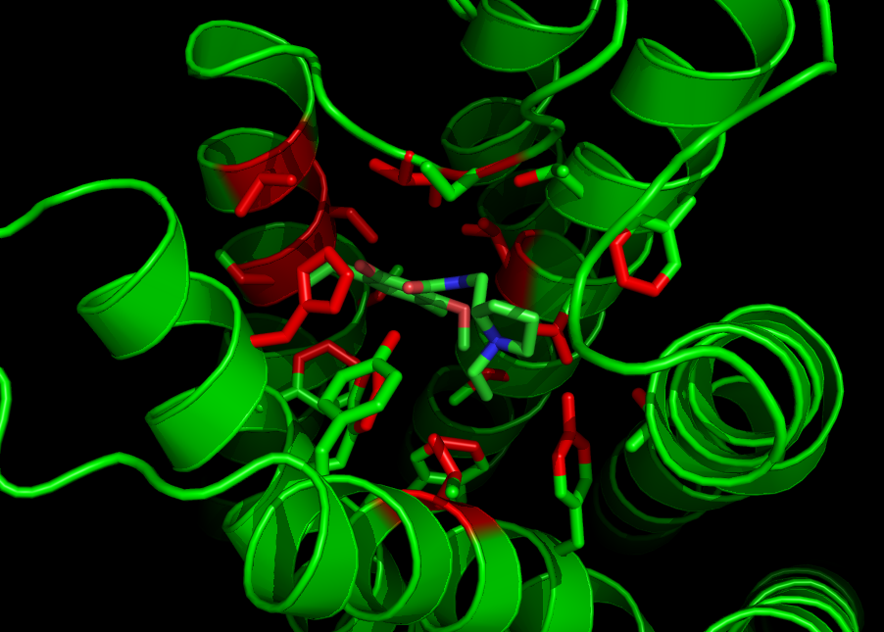
Move Maps, Interfaces, and Ligand Areas
Ligand area: identifies parameters for each ligand and identifies the atoms that are within a cutoff of the ligand

Slide 26
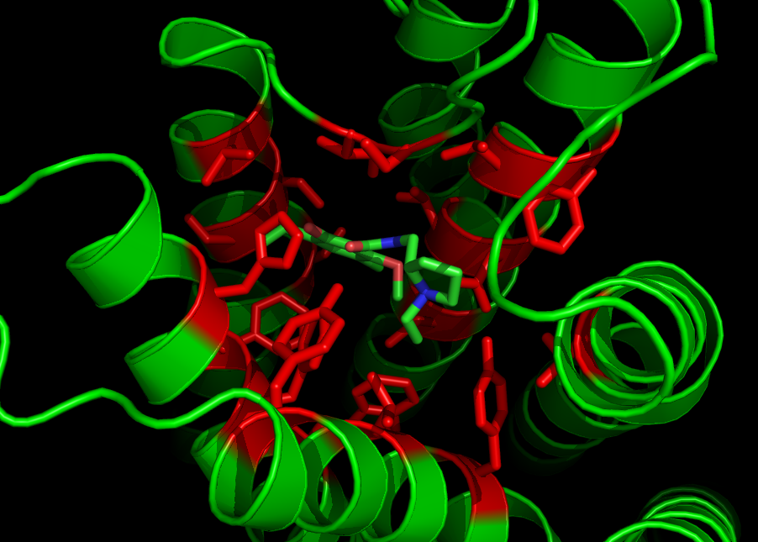
Move Maps, Interfaces, and Ligand Areas
Interface Builder: Extends those atoms to complete the residues

Slide 27
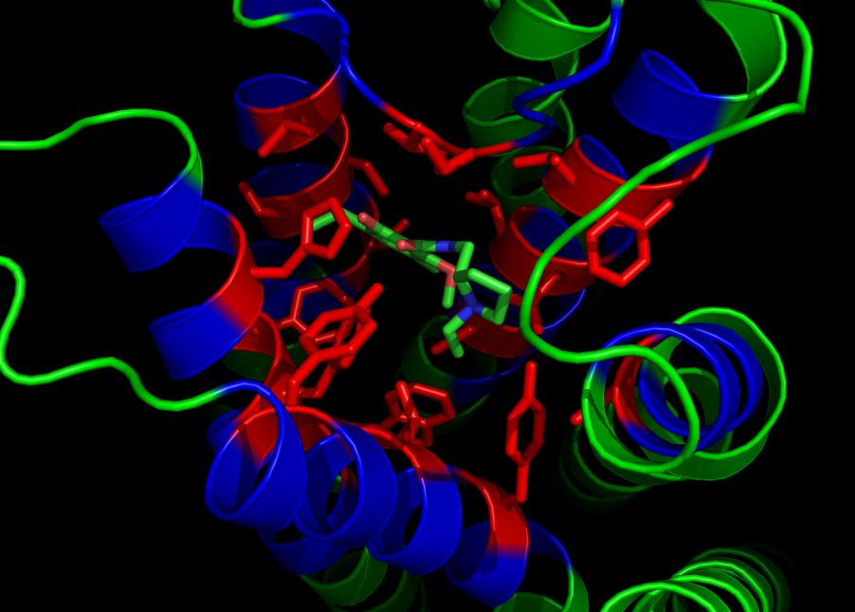
Move Maps, Interfaces, and Ligand Areas
Interface Builder: Extends to include surrounding residues for backbone flexibility

Slide 28
Move Maps, Interfaces, and Ligand Areas
Move map: identifies which residues are allowed to have backbone and side-chain movement. Typically, we have one for docking and one for minimization
Residue | Side-chain Movement | Backbone Movement
VAL 55 | No | Yes
VAL 56 | Yes | Yes
TYR 57 | No | Yes
LEU 58 | No | No
Note that these XML scripts defining Move Maps, Interfaces, Ligand Areas, etc. are set when you are running a dock. These have been benchmarked by developers so you won’t be changing these.
Notes:
boolean list

Slide 29
InterfaceScoreCalculator
<InterfaceScoreCalculator name=(string) chains=(comma separated chars) scorefxn=(string) native=(string)/>
Calculates ligand-specific scores based on bound complex vs separated complex
chains: ligand chains to perform calculation for
scorefxn: Use a hard repulsive to identify clashes
native: native or “correct” structure for rms comparison if available

Slide 30
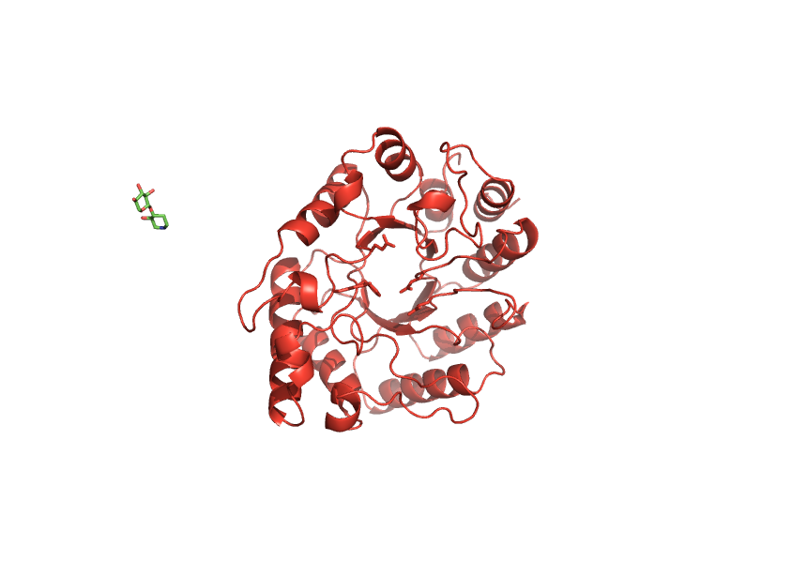
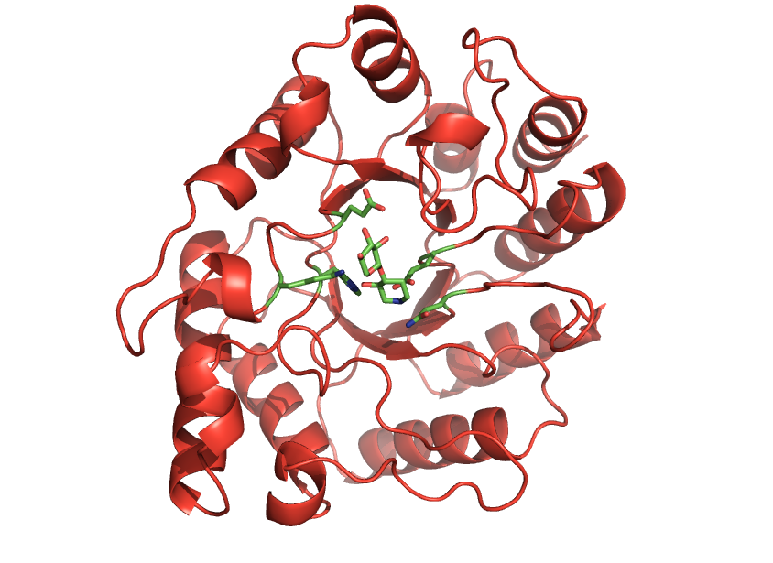
InterfaceScoreCalculator
interface_delta_X = Score(Bound) - Score(Unbound)
(Note: sidechains do NOT repack here)
Notes:
Does it repack?

Slide 31
FAQs
How many output poses should I make?
Depends.
Size of active site
Ligand--size, rotatable bonds, etc.
High-throughput screening?
Rosetta/tools/hts_tools/
(Deluca et al.)
How long do docking runs usually take?
Not long compared to other types of runs

Slide 32
References
Methodology
DeLuca, S., Khar, K. & Meiler, J. Fully Flexible Docking of Medium Sized Ligand Libraries with RosettaLigand. PLoS One 10, e0132508 (2015).
S. Combs et al., Small-molecule ligand docking into comparative models with Rosetta, Nature Protocols 8, 1277–1298 (2013).
G. Lemmon, J. Meiler, R. Baron, Ed. RosettaLigand docking with flexible XML protocols, Methods in Mol Biol 819, 143–155 (2012).
I. W. Davis, D. Baker, RosettaLigand docking with full ligand and receptor flexibility., Journal of molecular biology 385, 381–92 (2009).
K.W. Kaufmann et al., Small Molecule Rotamers Enable Simultaneous Optimization of Small Molecule and Protein Degrees of Freedom in ROSETTALIGAND Docking, German Conference on Bioinformatics, pp. 148–157 (2008)
J. Meiler, D. Baker, ROSETTALIGAND : Protein – Small Molecule Docking with Full Side-Chain Flexibility, Proteins 548, 538–548 (2006).

Slide 33
References
Applications
K. J. Gregory et al., Probing the metabotropic glutamate receptor 5 (mGlu5) positive allosteric modulator (PAM) binding pocket: discovery of point mutations that engender a “molecular switch” in PAM pharmacology., Molecular pharmacology 83, 991–1006 (2013).
B. Allison et al., Computational design of protein-small molecule interfaces., Journal of structural biology (2013), doi:10.1016/j.jsb.2013.08.003.
G. Lemmon, J. Meiler, Towards ligand docking including explicit interface water molecules., PloS one 8, e67536 (2013).
G. Lemmon, K. Kaufmann, J. Meiler, Prediction of HIV-1 protease/inhibitor affinity using RosettaLigand., Chemical biology & drug design 79, 888–96 (2012).
K. W. Kaufmann, J. Meiler, Using RosettaLigand for small molecule docking into comparative models., PloS one 7 (2012), doi:10.1371/journal.pone.0050769.
K. W. Kaufmann et al., Structural determinants of species-selective substrate recognition in human and Drosophila serotonin transporters revealed through computational docking studies., Proteins 74, 630–42 (2009).

Slide 34
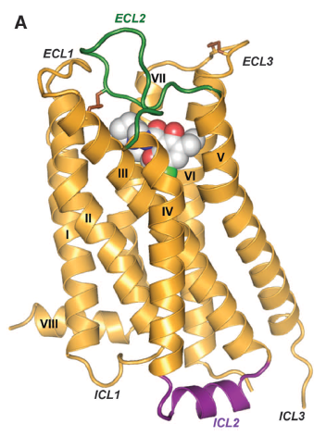
Today’s Tutorial
Docking of eticlopride (antagonist) to Dopamine Receptor Subtype 3
Rosetta Assessment
Nguyen, E. D. et al. Assessment and challenges of ligand docking into comparative models of g-protein coupled receptors. PLoS One 8, (2013)
Crystal Structure
Chien, E. Y. T. et al. Structure of the human dopamine D3 receptor in complex with a D2/D3 selective antagonist. Science 330, 1091–5 (2010)
Community Assessment
Kufareva, I. et al. Status of GPCR modeling and docking as reflected by community-wide GPCR Dock 2010 assessment. Structure 19, 1108–1126 (2011).
Eticlopride, a D2/D3 selective antagonist in complex with D3 Receptor

Slide 35
Let’s get started!
~/rosetta_workshop/ligand_docking
- Prepare protein files in protein_prep
- Prepare ligand files in ligand_prep
- Perform docking in docking
- Ligand docking specific scripts in scripts
- All answers here if you get stuck

